Slide 1
GreaterGrades Proposal
Presented By: Group 1

Slide 2
Project Overview

Slide 3
What Is GreaterGrades?
Grading App
Multiple institutions
Many to many teacher and class and user and class

Slide 4
Minimal Viable Product

Slide 5
Backend Features
Auth
CRUD for Classes, Users, Institutions, Assignments, and grades

Slide 6
Frontend
Submission forms
Grading page
Classes page

Slide 7
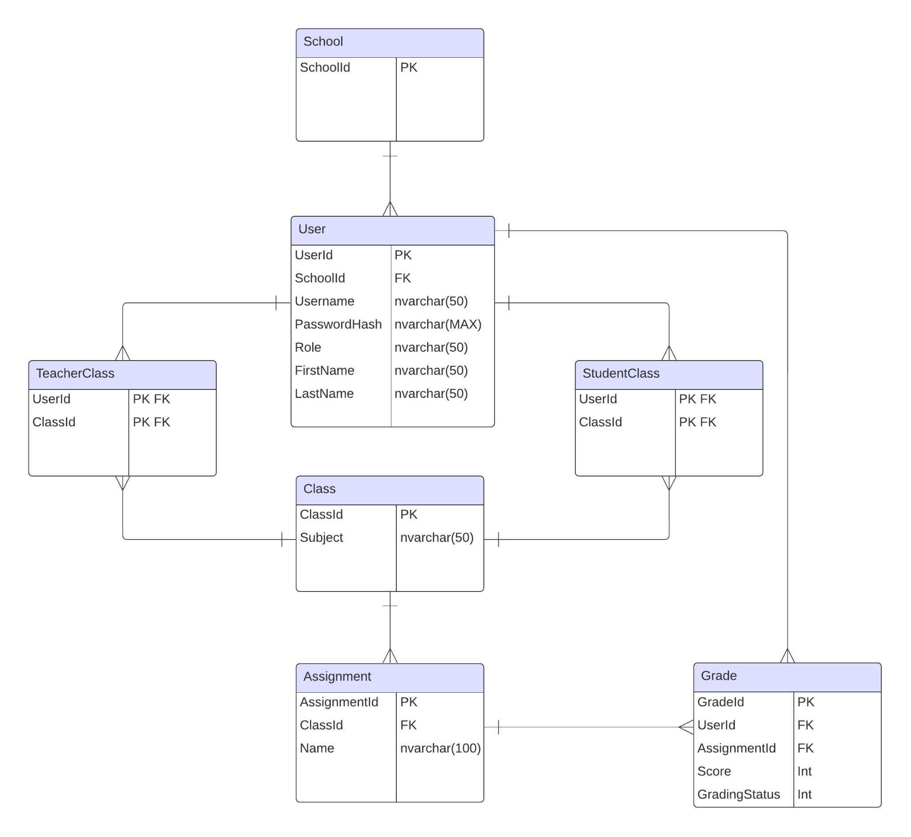
ERD

Slide 8
API
Goshippo Address Validation
Validating institution addresses
await sdk.Addresses.ValidateAsync({address-id});

Slide 9
Stretch Goals

Slide 10
Dockerization
Docker-Compose will be used to containerize the app (both front and back end)

Slide 11
CI/CD
Automated testing
Automated deployment

Slide 12
Websockets
Popup notifications on when your assignment is graded
Real time turn in information

